Slide 1







Skill Forecasting and
Semantic Career Pathway
Optimization Ecosystem
for Undergraduates
Al-driven career intelligence ecosystem for Sri Lankan IT undergraduates
Skill
Forecasting
Career Pathways
CV
Optimization
Interview Analytics
Project: R26-IT-128 | March 2026
Undergraduate research project focused on semantic career guidance, CV-job matching,
and interview simulation for the evolving Sri Lankan IT job market.
Notes:
1

Slide 2


Introduction
Bridging the IT Skills Gap in Sri Lanka
4
System
Components
The Problem: A widening qualitative skill gap between academic training and rapidly evolving IT industry demands
The Result: High uncertainty, delayed employability, and mismatched talent allocation
AI
Powered
Recognition
Undergraduates
Target
Audience
R26-IT-128
16/3/2026
Notes:
2

Slide 3



Users, Stakeholders, and Impact
Target Users
Key Stakeholders
IT Undergraduates and fresh graduates in Sri Lanka
Academic Institutions and the IT Industry
Impact on Users
Impact on Society
53.8% report university courses frequently fail to match job requirements
50.3% face high uncertainty in predicting future skill demands
49.1% cite nervousness and lack of confidence as their biggest technical interview challenge
Exacerbates skill shortages in Sri Lanka's IT sector, which contributes approximately 5% to the national GDP
R26-IT-128
16/3/2026
Notes:
3

Slide 4
Limitations of Current Systems
Existing Tools
Local job sites with basic functionality and conventional mock interview systems
Core Limitations
Data Blind Spots
Fail to process non-searchable job flyer images, which 46.9% of students rely on frequently
Rigid Matching
Rely on static keyword matching, ignoring semantic variations in skills
Lack of Forecasting
Do not provide short-term forecasting or predictive career modeling
No Behavioral Feedback
Ignore real-time attention detection, despite 61.3% of students knowing composure affects interview outcomes
R26-IT-128
16/3/2026
Notes:
4

Slide 5
SkillVerse: The Unified Ecosystem
Solution Overview
An integrated, AI-driven ecosystem that analyzes job trends, predicts pathways, optimizes resumes, and simulates interviews
How it Overcomes Limitations
Utilizes advanced NLP to handle semantic variations and unstructured image data
Incorporates short-term forecasting and probabilistic sequence modeling
Introduces real-time emotion detection for interview simulations
Validation
81.6% of surveyed undergraduates strongly agree this unified platform is more effective than separate tools
R26-IT-128
16/3/2026
Notes:
5

Slide 6

Semantic Skill Forecasting Engine
IT22154408 | RATHNAYAKE K D V
Contribution
This component helps IT undergraduates know exactly which technologies they should learn before they graduate. It reads job advertisements and predicts future skill demands. This supports the main goal of the RecruitAI system by giving students up-to-date market information, reducing the time they spend retraining in corporate "bootcamps" after graduation.
Novelty
Semantic over Syntactic Extraction
Global-Local Lead-Lag Analysis
Proactive Tactical Forecasting
IT22154408 | RATHNAYAKE K D V | R26-IT-128 ​
16/3/2026

Slide 7
Semantic Skill Forecasting Engine
Problem Definition
The IT industry changes very fast. University students often do not know exactly what specific skills companies want today. Because of this, major IT companies in Sri Lanka have to spend 3 to 6 months retraining fresh graduates before assigning them to projects. Therefore, an intelligent tool is needed to predict short-term skill demands so students can prepare early.
Main Objective
To develop an AI-based Semantic Skill Forecasting Engine that predicts short-term IT skill demands to help undergraduates prepare for the job market.
Sub Objectives
Develop a noise-reduced OCR data ingestion pipeline.
Cluster unstructured IT skills semantically using BERTopic.
Formulate and calculate global-to-local market lag times.
Forecast 3-month skill demand velocity to proactively minimize graduate bench time.
IT22154408 | RATHNAYAKE K D V | R26-IT-128 ​
16/3/2026

Slide 8


Semantic Skill Forecasting Engine
Technologies
Methodology
Python will be used as the main programming language. Image processing tools (like OpenCV and OCR) are used to read text from job advertisement images. Advanced Natural Language Processing (NLP) models are used to understand the text, and Time-Series algorithms are used to predict future trends.
A Design Science Research approach is used to create a predictive data tool. Knowledge from Data Science and Software Engineering is applied. The system will be designed, built, and mathematically tested to ensure the predictions are reliable.
Validation & Evaluation
Data & Ethics
The system is evaluated by testing how accurately it extracts text from images. The skill predictions will be tested against real past data (Historical backtesting) to see if the system's guesses match what actually happened in the job market.
The system only collects data from public job advertisement websites. It only extracts job requirements and titles. No personal details of applicants or recruiters will be collected. Ethical guidelines and website rules (like rate-limiting) are strictly followed during data collection.
IT22154408 | RATHNAYAKE K D V | R26-IT-128 ​
16/3/2026

Slide 9
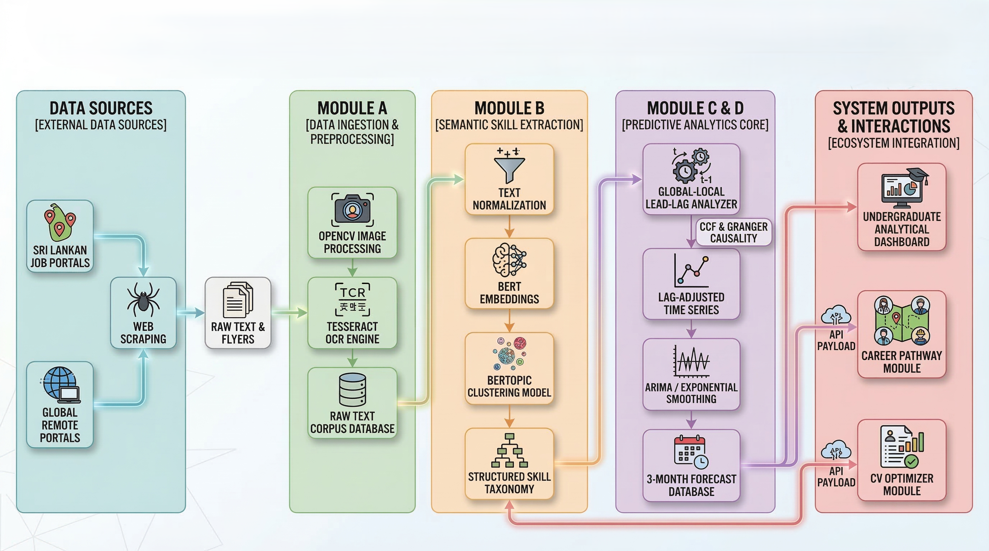
Semantic Skill Forecasting Engine
System Overview of the Component
IT22154408 | RATHNAYAKE K D V | R26-IT-128 ​
16/3/2026

Slide 10
Semantic Skill Forecasting Engine
System Overview
01
First, the system automatically collects job advertisements from local and global portals. Next, it cleans the text and uses AI to group similar skills. Then, it calculates future trends. Finally, it creates a structured list of predicted skills that will be highly demanded in the next 3 months.
Dependencies
02
This component acts as the main data provider for the other modules in the RecruitAI system. It sends the predicted skill lists to the Career Pathway module and the CV Optimizer module. This ensures the whole application uses future market trends instead of outdated historical data.
Implementation Details
03
Implemented using Python. It uses cloud-based scheduled tasks to collect new job data automatically. The extracted data is stored in a structured database, and the final predictions are sent to the other group members' modules using standard API connections.
IT22154408 | RATHNAYAKE K D V | R26-IT-128 ​
16/3/2026

Slide 11
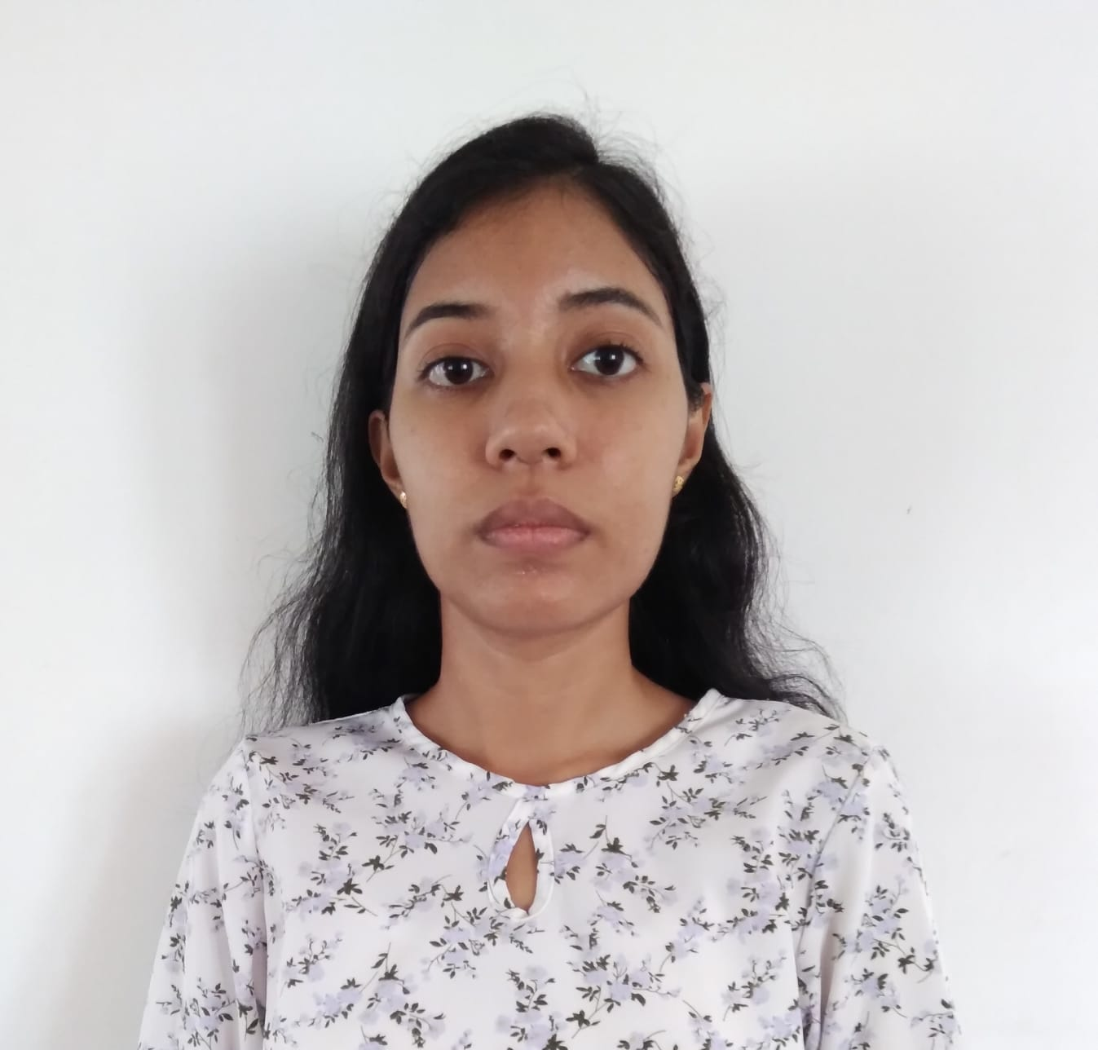
Hybrid Proficiency Validation Framework
IT22091802 | PRASADI R.D.S
This Component establishes a proficiency-based verification system that bridges the gap between academic projects and industry standards. It ensures students are matched to roles based on actual technical competency and project complexity rather than simple keyword presence. This reduces recruitment overhead for firms and prevents high-potential candidates from being hidden by depth-blind filters.
Contribution
Novelty
Semantic Depth Analysis
Hybrid Validation Model
Explainable Matching and Interpretable Competency Insights
16/3/2026
IT22091802 | PRASADI R.D.S | R26-IT-128

Slide 12
Hybrid Proficiency Validation Framework
Problem Definition
IT recruitment faces "Skill Depth Blindness" as keyword-based ATS filters cannot distinguish between superficial knowledge and demonstrated expertise. This leads to a verification crisis where genuine undergraduate talent is often filtered out by automated systems due to a lack of verified technical depth.
Main Objective
To develop a semantic proficiency inference and weighted matching framework that estimates technical skill levels from CVproject descriptions and GitHub analysis to improve recruitment accuracy and CV-job matching.
Sub Objectives
To implement a RoBERTa-based classification model to infer skill proficiency levels from project text.
To develop a GitHub validation module using CodeBERT to verify proficiency claims via repository and README analysis..
To create a weighted matching algorithm that applies expertise-based weights. (0.3, 0.7, 1.0) against real-time job requirements
To integrate an explainable feedback system to help students improve their technical project descriptions.
16/3/2026
IT22091802 | PRASADI R.D.S | R26-IT-128

Slide 13
Hybrid Proficiency Validation Framework
Technologies
Methodology
The system utilizes deep learning models, specifically fine-tuned RoBERTa for text classification and CodeBERT for code analysis. It is implemented using Python, PyTorch, and Hugging Face Transformers, with spaCy for NLP preprocessing and MongoDB for structured data storage.
Following a Design Science Research (DSR) approach, the framework operates through a pipeline of text extraction, semantic proficiency classification, optional GitHub hybrid validation, and proficiency-weighted Cosine Similarity matching against scraped job data.
Validation & Evaluation
Data & Ethics
Performance is assessed via classification accuracy and model reliability. Proficiency levels and match scores are validated against expert annotations to ensure technical precision. Findings are cross-referenced with historical job data for real-world alignment and benchmarked against local research to verify superior technical depth assessment.
The system mainly uses letter templates and user interaction data for tracing activities. Any feedback or survey data collected will be kept confidential. Ethical guidelines are followed when collecting feedback from users.
16/3/2026
IT22091802 | PRASADI R.D.S | R26-IT-128

Slide 14
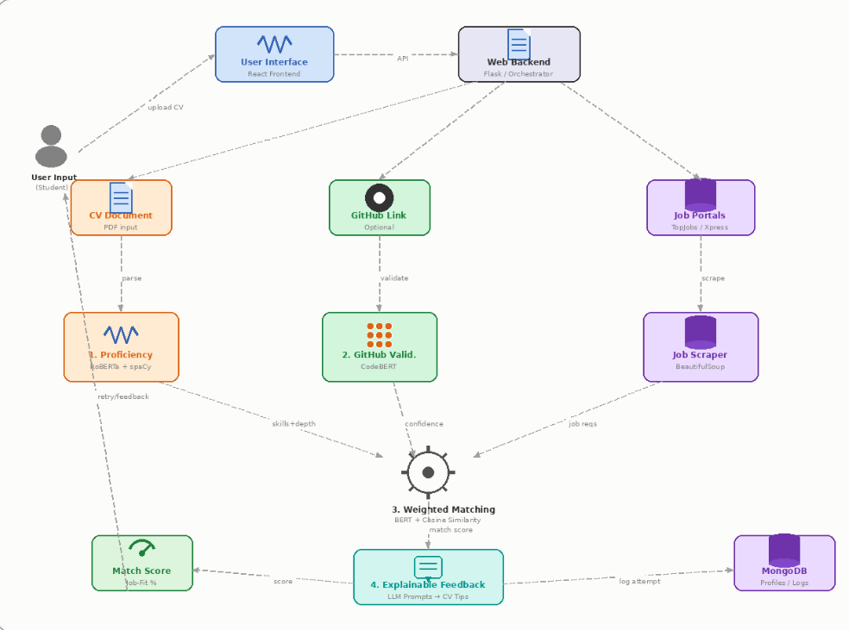
Hybrid Proficiency Validation Framework
System Overview
01
The framework processes CV project descriptions to identify technical complexity and action verbs, translating them into tiered proficiency scores. It optionally integrates GitHub signals to boost confidence before calculating a final weighted job-fit percentage.
Dependencies
02
Execution relies on accurate PDF text extraction from varied resume formats and stable access to the GitHub API. It also requires a reliable web scraper for fetching live job requirements from local platforms such as TopJobs.lk and Xpress.jobs.
Implementation Details
03
The system uses weighted BERT embeddings to quantify skills (Beginner=0.3, Intermediate=0.7, Advanced=1.0). A feedback engine powered by a lightweight LLM generates personalized suggestions to help candidates better articulate their technical expertise.
.
16/3/2026
IT22091802 | PRASADI R.D.S | R26-IT-128

Slide 15

AI-Powered Simulation with Real-Time Attention Tracking
IT22291264| Kavindu D.M.G
Contribution
This component strengthens the overall intelligent career guidance solution by introducing an AI-driven interview simulation module for Sri Lankan IT undergraduates. It contributes to the main system through role-specific question generation, webcam-based emotion recognition, behavioral monitoring, and performance analytics visualization. By combining technical practice with behavioral assessment, the module supports continuous improvement in interview preparedness, confidence, and self-evaluation.
Novelty
This component introduces a multimodal AI-based interview preparation mechanism that combines large language model driven dynamic question generation with computer vision–based emotion recognition. Unlike existing interview practice tools that primarily depend on predefined question sets and manual feedback, the proposed system generates context-aware interview questions and simultaneously evaluates emotional engagement during responses. This integrated approach enables both technical interview practice and behavioral performance assessment, making the solution more intelligent, adaptive, and effective for interview readiness improvement
16/3/2026
IT22291264 | Kavindu D.M.G| R26-IT-128

Slide 16

AI-Powered Simulation with
Real-Time Attention Tracking
Problem Definition
Interview preparation can be difficult for Sri Lankan IT undergraduates because many students use static question banks, YouTube videos, or peer practice. These methods help with technical knowledge, but they do not give proper feedback about confidence, emotion, hesitation, and attention during interviews. Existing mock interview tools also do not effectively track overall interview performance, which limits students’ ability to improve their interview skills over time.
Main Objective
To develop an AI-based interview simulation component that supports Sri Lankan IT undergraduates by providing dynamic interview practice, real-time emotion and attention analysis, and performance feedback for continuous improvement.
Sub Objective
Develop a system to generate role-specific interview questions using a Large Language Model.
Use webcam-based facial analysis to detect emotion and attention levels during interview responses.
Apply MediaPipe and a pretrained MobileNet model for real-time behavioral analysis.
Provide dashboard-based feedback to track interview performance over time.
16/3/2026
IT22291264 | Kavindu D.M.G| R26-IT-128

Slide 17
AI-Powered Simulation with Real-Time Attention Tracking
Technologies
Methodology
Uses Large Language Models for dynamic interview question generation, MediaPipe for face and landmark detection, MobileNet for lightweight emotion or attention recognition, optional Vision-Language Model comparison, React for frontend development, Python / FastAPI for backend services, and a database for storing interview session data and analytics.
Follows the Design Science Research methodology: problem identification, requirement analysis, system design, implementation, and evaluation. The project combines knowledge from Artificial Intelligence, Computer Vision, Human-Computer Interaction, and Software Engineering to build and test an intelligent interview preparation system.
Validation & Evaluation
Data & Ethics
Validated through functional testing, usability testing, and performance evaluation of the interview simulation system. The behavioral analysis component will be tested by comparing the MobileNet-based model and the Vision-Language Model approach using measures such as accuracy, speed, and suitability for real-time interview assessment.
Uses interview-related datasets, role-based question prompts, and webcam-captured facial data during mock interview sessions. Security measures include secure storage, controlled access, and responsible handling of session data. Ethical considerations include participant consent, privacy protection, and proper use of webcam-based emotion analysis.
16/3/2026
IT22291264 | Kavindu D.M.G| R26-IT-128

Slide 18
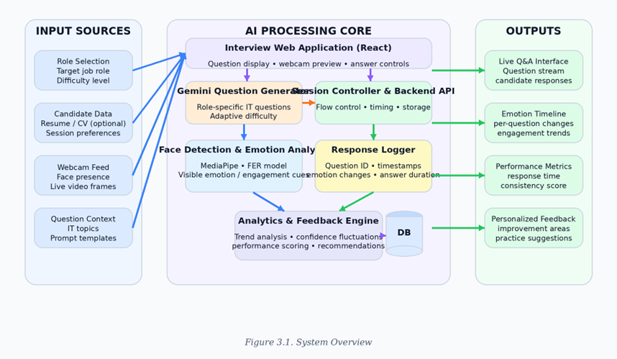
AI-Powered Simulation with Real-TimeAttention Tracking
System Overview
01
This module allows Sri Lankan IT undergraduates to practice interviews in a realistic digital environment. It generates role-specific interview questions using AI, captures webcam video during responses, and analyzes emotion and attention levels in real time. The system then shows performance results and behavioral feedback through an interactive dashboard.
Dependencies
02
Depends on several shared system components: Large Language Model for dynamic question generation, MediaPipe for face and landmark detection, MobileNet-based emotion or attention recognition, optional Vision-Language Model for comparison, user authentication, frontend interface, backend API, and database for storing session data and analytics.
Implementation Details
03
Students answer AI-generated questions while the system captures webcam data to analyze emotion, attention, and behavior. Results are stored and shown through a dashboard.
16/3/2026
IT22291264 | Kavindu D.M.G| R26-IT-128

Slide 19
Career Pathway Prediction: Temporal Graph-Based Trajectory Modeling
IT22153890| ALPHONSO S.R.P.A.M.D.N
Contribution
This component helps IT undergraduates visualize and understand their possible career futures before they enter the job market. It analyzes real career histories of Sri Lankan IT professionals to predict probable career paths from a student's current position. This supports the main goal of the RecruitAI ecosystem by providing evidence-based career guidance, reducing uncertainty, and helping students make informed decisions about their professional development
Novelty
Localized Temporal Knowledge Graph – First career trajectory graph built specifically from Sri Lankan IT professional data, capturing how careers actually evolve in the local market
Small-Data Transformer Adaptation – Sequence model adapted to work with limited Sri Lankan data using transfer learning, making sophisticated prediction accessible to smaller labor markets
Probabilistic Pathways with Explainability – Multiple possible futures shown with confidence estimates and evidence trails, not just a single "best" path
16/3/2026
IT22153890 | Alphonso S.R.P.A.M.D.N. | R26-IT-128

Slide 20

Career Pathway Prediction:
Temporal Graph-Based Trajectory Modeling
Problem Definition
IT students graduate without knowing what career paths are possible or which directions lead to success. They rely on anecdotal advice from seniors or generic online resources that do not reflect Sri Lanka's unique job market. Career counselors lack data-driven tools to advise students effectively. As a result, graduates make poor career choices, face job dissatisfaction, and waste years in roles that do not leverage their potential. A system is needed to show students evidence-based career trajectories using real local data
Main Objective
To develop a graph-based career pathway prediction system that models probable IT career trajectories for Sri Lankan undergraduates by integrating temporal knowledge graph construction with probabilistic sequence modeling
Sub Objective
Construct a temporal knowledge graph from anonymized career histories of Sri Lankan IT professionals
Design a Neo4j graph database schema optimized for career path analysis and traversal queries
Develop a transformer-based sequence model that learns transition probabilities from career sequences
Create an interactive visualization interface for exploring predicted pathways
16/3/2026
IT22153890 | Alphonso S.R.P.A.M.D.N. | R26-IT-128

Slide 21
Career Pathway Prediction: Temporal Graph-Based Trajectory Modeling
Technologies
Methodology
Python is used as the main programming language. Neo4j serves as the graph database for storing career trajectories and enabling path queries. Hugging Face Transformers provide pre-trained models fine-tuned for career sequence prediction. PyTorch handles deep learning implementation. React with D3.js creates interactive graph visualizations. FastAPI connects the backend models to the frontend interface
A Design Science Research approach is used to create a predictive modeling tool. Knowledge from Graph Theory, Deep Learning, and Human-Computer Interaction is applied. Career histories are collected ethically, transformed into a temporal knowledge graph, and used to train transformer models. The system will be built, tested against historical data, and evaluated with real users to ensure usefulness
Validation & Evaluation
Data & Ethics
The system is evaluated quantitatively by testing prediction accuracy against held-out career sequences (20% of data). Metrics include next-position accuracy (target >80%), recall@3 (target >90%), and transition timing error. The model is compared against Markov and LSTM baselines. Qualitative evaluation involves user testing with 5-8 career counselors and 15-20 students to assess usefulness, interpretability, and trust
Career data is collected from public LinkedIn profiles (manual, ethical collection), de-identified university alumni records, and voluntary surveys with informed consent. All personal identifiers are removed before storage. Data is encrypted and stored on university servers with access restricted to the research team. Ethical approval will be obtained from SLIIT Ethics Review Committee. Website terms of service and rate-limiting are respected during data collection
16/3/2026
IT22153890 | Alphonso S.R.P.A.M.D.N. | R26-IT-128

Slide 22




Commercialization Potential & Investment
The proposed Skill Forecasting and Semantic Career Pathway Optimization Ecosystem has strong commercialization potential. With growing demand for AI-ready IT graduates in Sri Lanka, a localized platform using BERT embeddings, ARIMA forecasting, and semantic CV-job matching provides unique value unavailable in existing global or local platforms.
Possible Pricing Models
Freemium Model
School Licensing
Subscription Model
Educational Partnerships
Basic skill analytics and career graph free. Advanced CV optimizer, full interview simulator, and ARIMA forecasts via monthly subscription..
Annual B2B license for universities and career guidance units. Provides Skill Analytics Dashboard for data-driven curriculum planning.
Students subscribe monthly or annually for full platform access including career pathways, semantic CV-job matching, and interview simulation.
Collaborate with SLIIT, HR firms, and industry partners to integrate the platform into graduate placement and employability programs.
R26-IT-128
16/3/2026

Slide 23

Target Market, Value Proposition &
Intellectual Property
Target Market & Customer Profile
Value Proposition
Intellectual Property Rights
IT undergraduates (final-year) transitioning to industry roles in software development, data science, and AI. Also targets academic institutions and career guidance units in Sri Lanka seeking to align curricula with real-time market shifts.
A localized AI-driven ecosystem offering probabilistic career trajectories from real-time Sri Lankan job portal data, semantic CV-job matching, and an Interview Simulator with real-time behavioral feedback for both technical and soft-skill assessment..
Proprietary algorithms for weighted skill matching and career pathway prediction in Neo4j are protected as trade secrets. Custom-trained NLP models and the integrated feedback loop constitute original IP. All data acquisition follows ethical scraping and privacy-compliant protocols.
R26-IT-128
16/3/2026

Slide 24
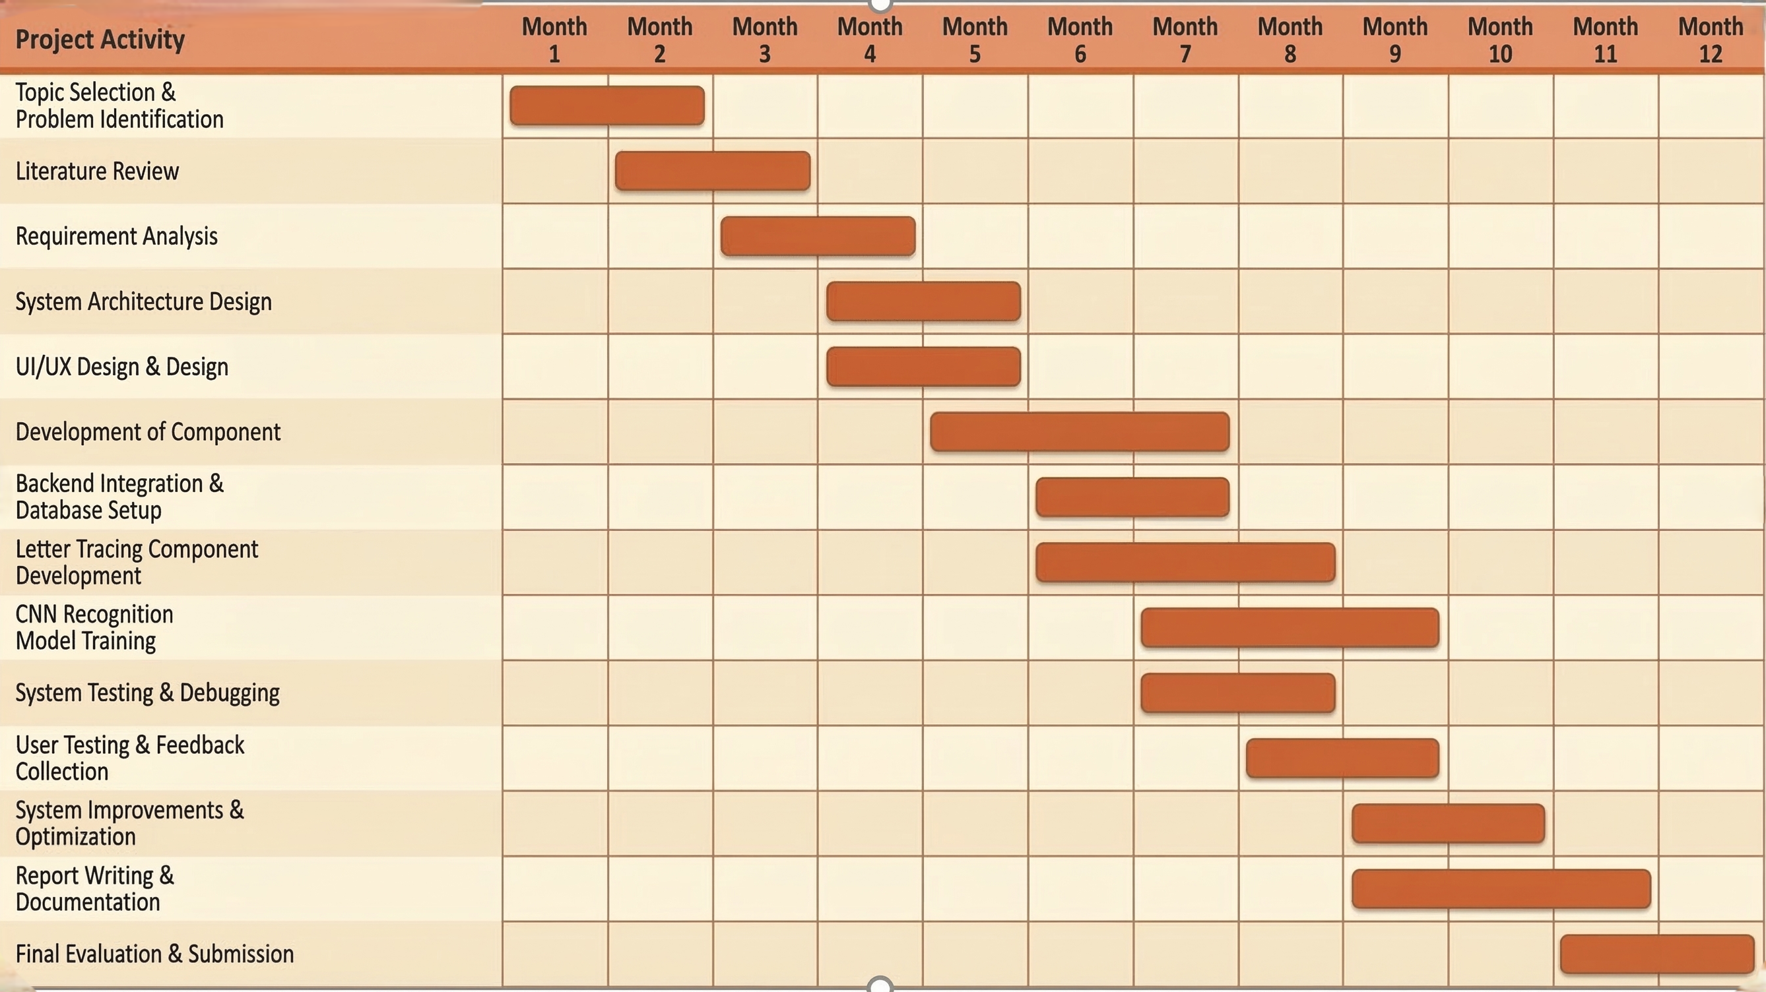
Gantt Chart — Project Timeline
R26-IT-128
16/3/2026

Slide 25

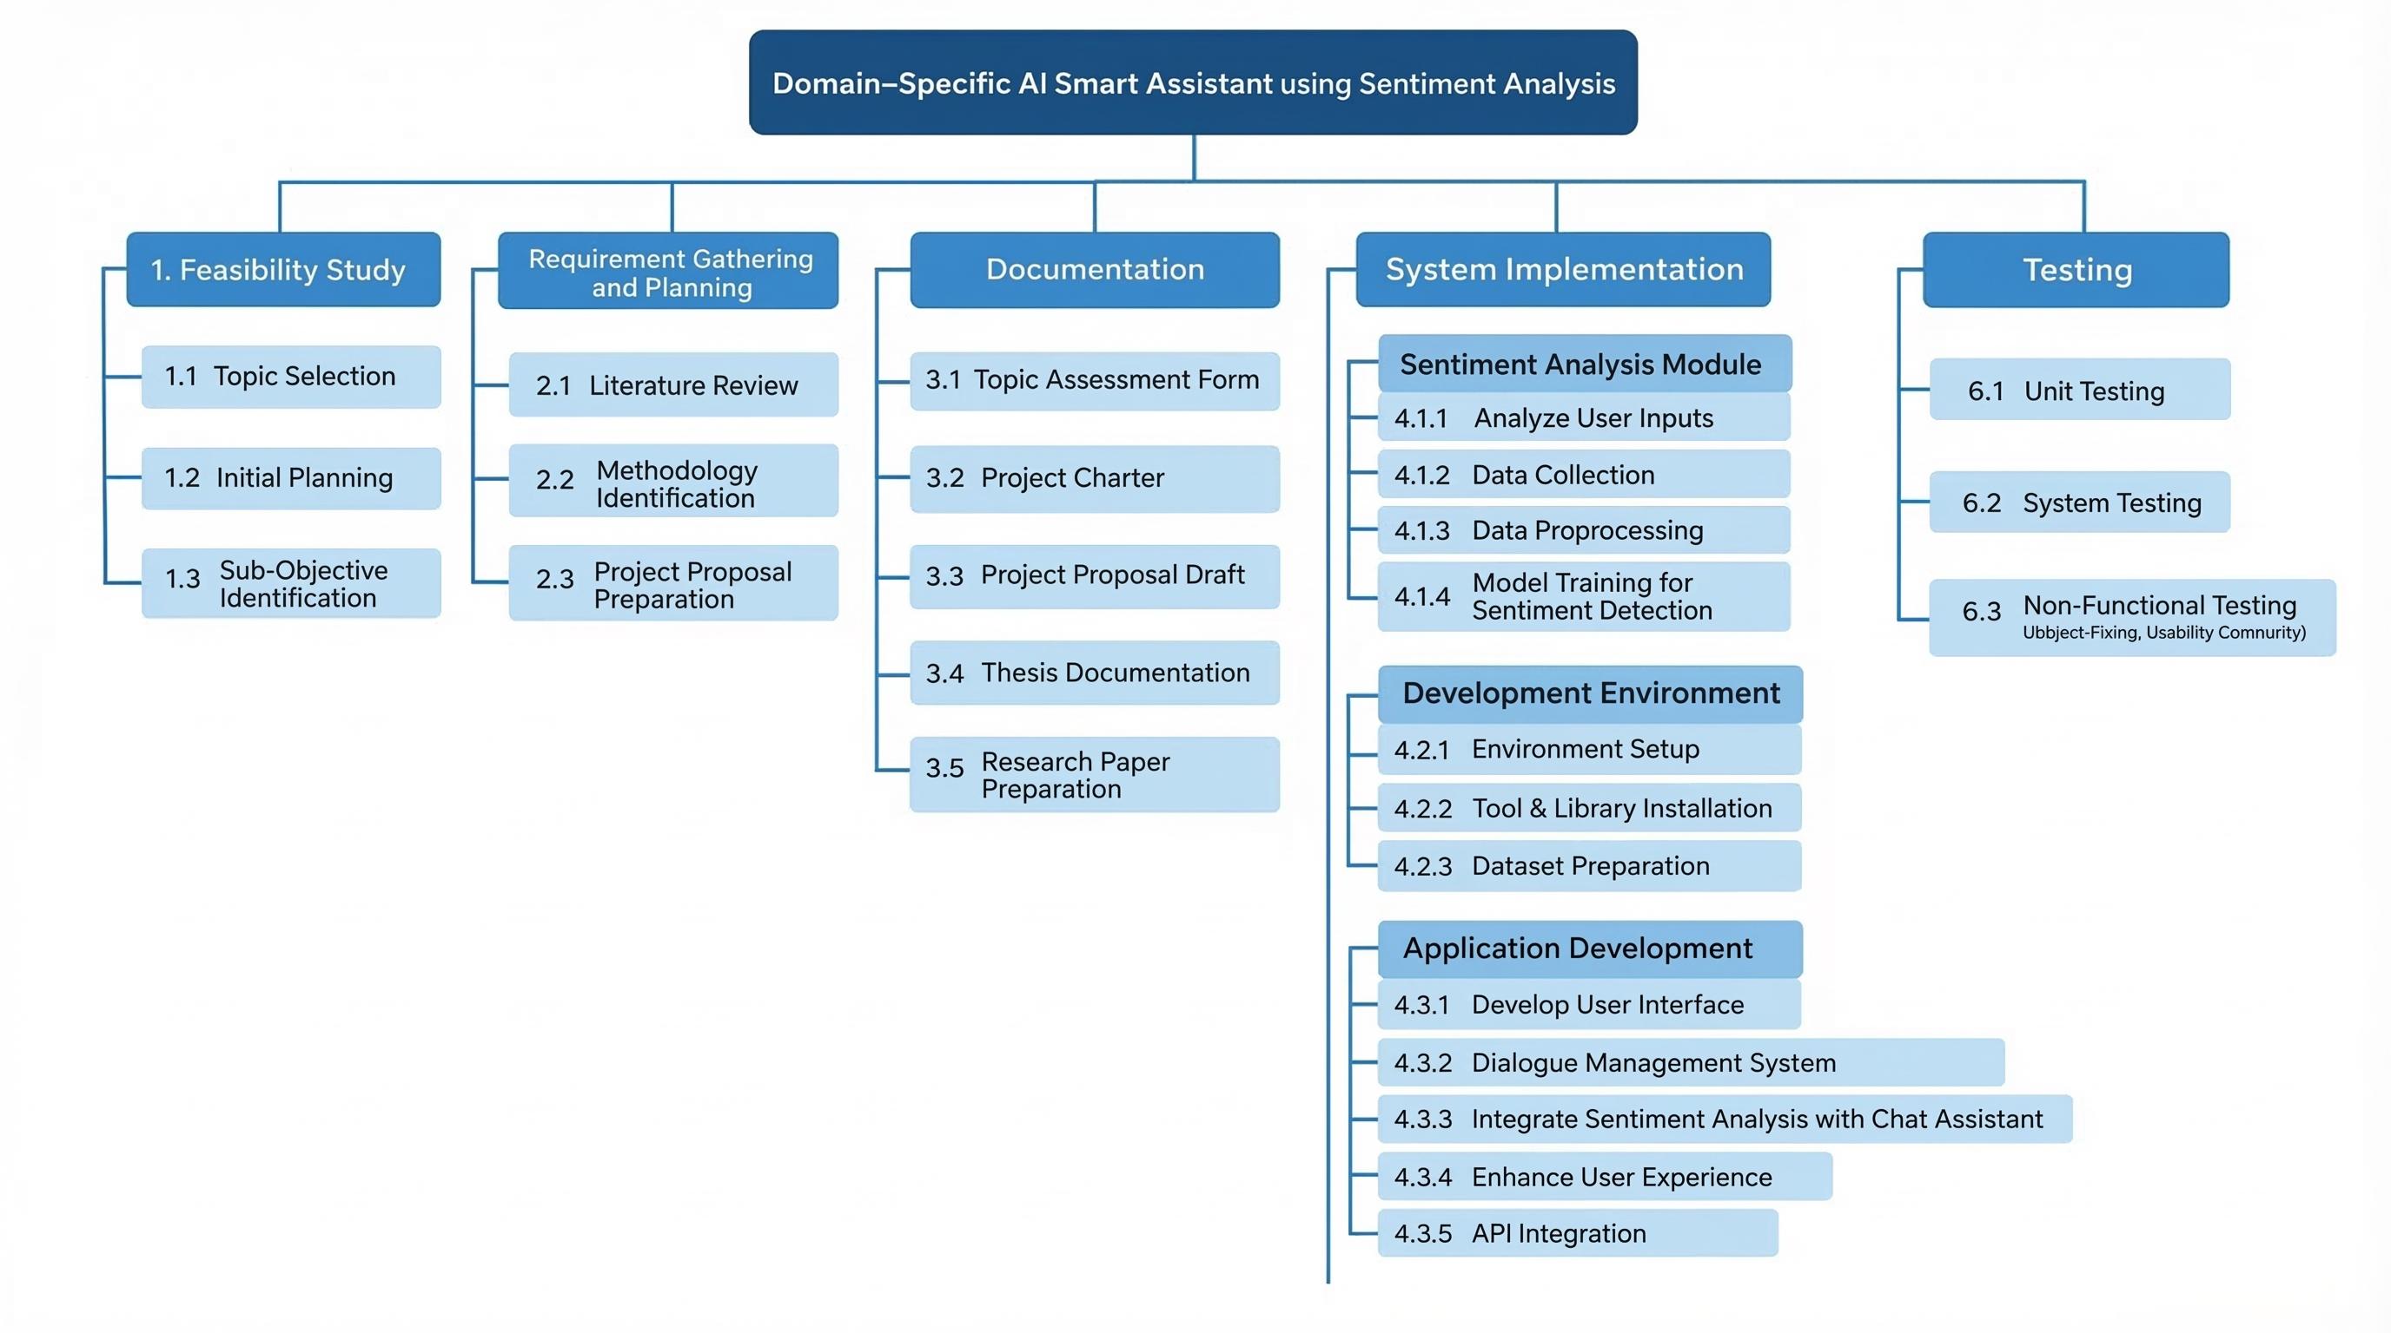
Work Breakdown Structure
R26-IT-128
16/3/2026

Slide 26


Thank You
R26-IT-030
16/3/2026

